Slide 1

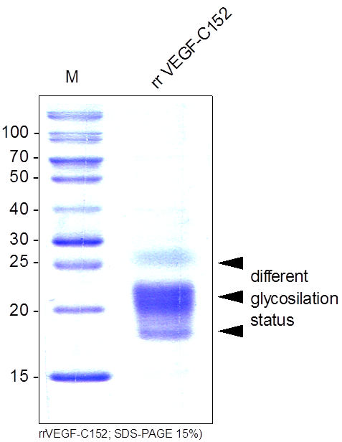
ReliaTech GmbH
Recombinant rat VEGF-C152
(Cat #R20-016 / -017 )
Fig. 1: SDS-PAGE analysis of recombinant rat VEGF-C₁₅₂. Samples were loaded in 15% SDS-polyacrylamide gel under reducing conditions and stained with Coomassie blue.
http://www.reliatech.de / orders@reliatech.de

